Slide 1
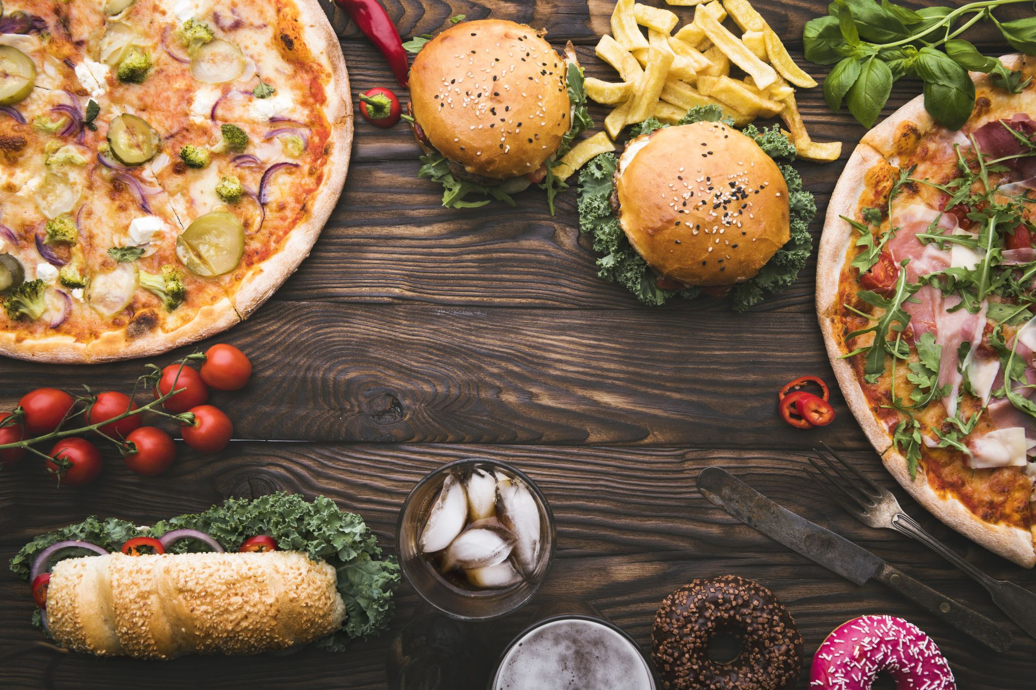
Brockport Eats (B.P. Eats)
By Yusuf Unsal
Aschby Gurpersaud
Dominic Adu Agyei

Slide 2
Introduction
The main problem that students are experiencing is the absence of a food delivery service.
This system will not only help students but will provide business opportunities for SUNY Brockport as well as help small businesses around the area.
Our inspiration came from other food delivery services such as Uber Eats and Door Dash
Dining hall current services

Slide 3
Planning Phase - Baseline Project Plan:
Business Value: BrockportEats aims to enhance the campus community's dining experience by providing a convenient and efficient platform for ordering meals from local restaurants. The app seeks to promote local businesses and offer students a diverse range of food options.
Staff: The project team includes developers, UI/UX designers, and project managers with experience in app development and local business partnerships.

Slide 4
Analysis Phase - System Requirements:
Strategy: The app strategy involves creating a seamless, user-friendly platform that connects students with local restaurants, offering a diverse range of cuisines.
Use Cases Analysis: Use cases involve students placing orders, restaurants receiving and fulfilling orders, and drivers delivering orders to users.

Slide 5
Design Phase - System Specification:
Design Selection: The chosen design focuses on a mobile-first approach with a clean and visually appealing interface, emphasizing ease of use for both students and restaurant owners.
Program Design: The app's architecture is designed to facilitate efficient communication between the user interface, database, and external APIs for menu integration and payment processing.

Slide 6
Implementation Phase - New System and Maintenance Plan:
User Interface Design: The UI is designed to provide an intuitive ordering experience, with features such as a personalized user dashboard, interactive menus, and a seamless checkout process.

Slide 7
Inputs
Initially, our inputs will be taken from the user
The first set of inputs will be dedicated to application accessibility.
The second set of inputs will be dedicated to navigational procedures.
The third set of inputs will be dedicated to selection operations.

Slide 8
Outputs
After the accessibility input data is processed, the app will output the main home screen, or the account creation page.
The navigational inputs when processed, will direct the user within the app accordingly.
After processing the selection input, the app will generate detailed order confirmations with estimated times of arrival, payment confirmation, and information of what was ordered.
In addition, order fulfillment receipts will be followed by feedback requests for our services.

Slide 9
Processes
The accessibility input data will be processed depending on the user status.
The navigational inputs will be processed based what the user selected.
The selection inputs will be processed based on the availability and price of their choices.

Slide 10
Feasibility Assessment
A) Economic:
Cost Estimation: The development costs, including software development($12,000), design($5,000), testing, server infrastructure, marketing($500), and ongoing maintenance($500).
Revenue Projection: Potential revenue streams, such as delivery fees($1,000), commission from restaurants(5%- 15%), and advertising($250).
Return on Investment (ROI): The expected ROI by comparing development costs to projected revenues over time. (ROI = [($25,000 - $6,000) / $17,500] * 100 = 108.6%)

Slide 11
Feasibility Assessment
C) Operational-Business Feasibility:
Business Model: The food delivery app operates on a commission-based, platform-as-a-service (PaaS) model, connecting college students, faculty, and local residents with a wide selection of restaurants and eateries in the vicinity of SUNY Brockport.
Marketing and User Acquisition: Target audience, branding, social media marketing, college partnerships, referral program, and influencer marketing.

Slide 12
Feasibility Assessment
F) Schedule-Timeline Feasibility:
Member Roles:
Yusuf – Business Analyst
Aschby – Analyst
Dominic – Code/Development
Project Timeline:
- Meeting Times: 5pm – 8pm Monday, Wednesday, Friday
Meeting Place: Virtual and/or Campus
Launch date: 12/06/23

Slide 13
Business Requirements
The business will implement a on campus food delivery system for students
The business will generate revenue based on delivery fees and sponsorships
The business will create business opportunities for partnerships with small business around the local Brockport area

Slide 14
User Requirements
The user must sign up with their student email and Student ID
The user must select the appropriate residential hall address
The user must choose an appropriate method of card payment
The drivers must be within a 20 miles radius from the campus
Restaurant must sign up with the appropriate location and within 10 -mile radius

Slide 15

Functional Requirements
User Management
1.1 The system shall enable user registration and account creation.
1.2 The system shall allow users to update their personal information, delivery addresses, and payment methods.
1.3 The system shall provide users with access to order history and real-time order tracking.
1.4 The system shall support a loyalty program for users to earn and redeem rewards.
Order Management
2.1 The system shall enable users to browse restaurant listings, select menu items, and customize their orders.
2.2 The system shall calculate the total order cost, including delivery fees and taxes.
2.3 Users shall have the option to provide feedback and ratings for delivery experiences and food quality.
2.4 Orders shall be transmitted to the chosen restaurant for preparation.
2.5 The system shall send push notifications to users when their orders are on their way.
Restaurant Management 3.1 The system shall display a list of partnered restaurants, including restaurant names, cuisine types, menu items, prices, and ratings.
- Restaurant must be able to customize their menu options and prices
Driver Management:
- 2.6 Driver must be able to view/accept orders
- 2.7 Driver must be able to cancel orders
Administration
2.8 All user registrations shall be verified by Admin

Slide 16
Non-functional Requirements
Operational
1.1 The app should be compatible with tablet devices used by college students and residents.
1.2 The app should be web-based and accessible on major web browsers.
1.3 The app should facilitate wireless connectivity to printers for order receipts and notifications.
1.3 Users can save their login information for quicker login.
Performance
2.1 The app should provide quick response times, with actions completed in 3 seconds or less.
2.2 The app's data, including new orders and restaurant information, should be updated every 5 minutes.
Security
3.1 User accounts and personal information should be stored securely and in compliance with data protection regulations.
3.2 Only authorized personnel, such as the customization shop supervisor, may approve non-standard customizing options.
3.3 Access to the app on tablet devices should be restricted to the assigned salesperson.
Cultural and Political
4.1 Compliance with company policies regarding technology procurement, such as purchasing computer equipment from specific vendors, should be maintained.

Slide 17
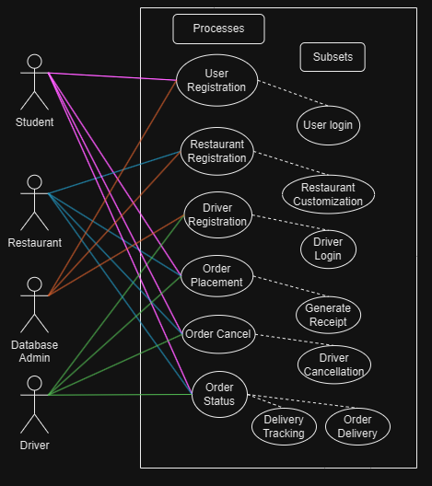
Overall Use Case Diagram

Slide 18
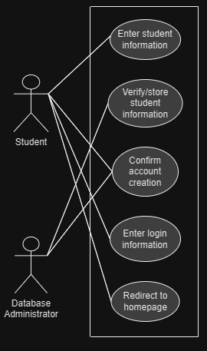
User Registration
Use case diagram: U-1
User will enter their student information
Admin will verify the student information in the database
After verification, user account is created
User can now login
User is redirected to the BPeats homepage

Slide 19
User Registration: U-1
Use Case Name: User Registration Priority: High |  |  |  | ID: U-1
Short Description: New users register on the Brockport Eats app, providing personal information, creating a username and password, and adding delivery addresses.
Trigger: User wants to create an account. Type: External / Temporal
Major Inputs: |  | Major Outputs:
Description: User first last name, Student email, phone, student ID username and password Delivery address Verification email | Source: User | Description: Confirmation email with a verification link User registration and profile creation | Destination: System application System Database
Major Steps Performed: The user enters their info. The system database admin validates the registration information The system sends a confirmation email for the user to verify their account creation The system securely stores user information in a database for future use, ensuring data privacy and security. The user enters their login info The system database validates their credentials. System will redirect user to the BPeats homepage after verified login |  | Information for steps: User information System user Database admin User email System database, user info User login information System user database BPeats Homepage

Slide 20
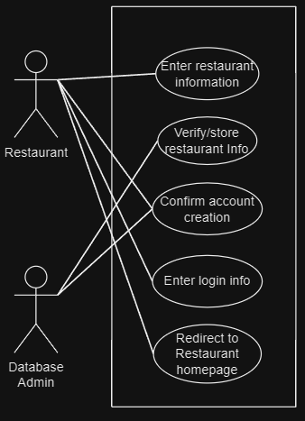
Restaurant Registration
Use Case Diagram: U-2
Restaurant will enter their student information
BP Eats database admin will verify the restaurant information
After verification, restaurant account is created
The newly created restaurant account is now visible and customizable

Slide 21
Restaurant Registration: U-2
Use Case Name: restaurant registration Priority: High |  |  |  | ID: U-2
Short Description: Restaurants create register themselves in the app so users can order from them and they can customize their menus.
Trigger: a restaurant wants to register themselves in the app Type: External / Temporal
Major Inputs: |  | Major Outputs:
Description: Restaurant name Menu items Menu prices Hours Location | Source: Restaurant | Description: Restaurant enters their info, then gets a profile created in their account which allows them to sell their menu items and customize their menu options. | Destination: System application , System database
Major Steps Performed: The restaurant enters their information The system database admin validates their information by checking their location ensuring that the restaurant is legitimate and within a 10-mile radius of the campus System will create a restaurant profile for the restaurant The restaurant can now login to their account The restaurant can customize their menu items and prices to their liking |  | Information for steps: Restaurant information System Database, admin, restaurant info Restaurant and menu items. Restaurant login info Restaurant menu items, prices, hours

Slide 22
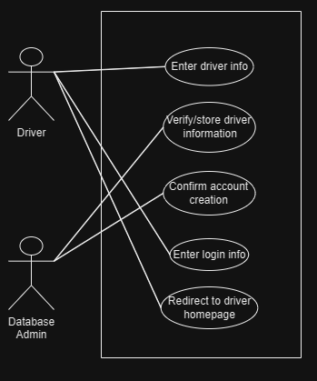
Driver Registration
Use Case Diagram: U-3
Driver will enter their information
Database admin will verify and store the driver information
The driver account is created
The driver can now login to the Bpeats app

Slide 23
Driver Registration: U-3
Use Case Name: Driver registration Priority: High |  |  |  | ID: U-3
Short Description: Drivers can register themselves in the BPEats app to conduct deliveries.
Trigger: a driver wants to create an account Type: External / Temporal
Major Inputs: |  | Major Outputs:
Description: Driver first last name Driver vehicle model Driver age and license status Direct deposit | Source: Driver | Description: Driver enters their information which gets verified, then a newly created driver account is created for them in the BPeats app. | Destination: System application , System database
Major Steps Performed: The driver enters their information The system database admin validates their information by checking their driver’s license and ensuring that they own a vehicle. System then creates the driver account The driver can now login to their account Driver can then see their delivery jobs to do in their account and cancel jobs if needed |  | Information for steps: Driver information System Database, admin, driver info Driver info System application Driver info Drive login info Driver account, driver info

Slide 24
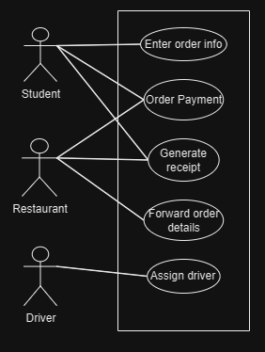
Order Placement
Use case diagram: U-4
Student enters the order information
Student enters their payment info and checks out the order
The BPeats system generates order receipt
The Bpeats system forwards order details
The BPeats system assigns a driver for the order delivery

Slide 25
Order Placement: U-4
Use Case Name: Order Placement Priority: High |  |  |  | ID : U-4
Short Description: Users browse restaurant listings, select menu items, customize orders, and place them.
Trigger: User wants to place an order Type: External / Temporal
Major Inputs: |  | Major Outputs:
Description: Restaurant name, menu items, prices User’s information, menu selections, customization payment details and payment method Driver Name, vehicle model | Source: User Restaurant Driver | Description: Order confirmation with estimated delivery time Generated order receipts | Destination: User System
Major Steps Performed: The user selects their restaurant choice, menu items, and customizations The user goes to the checkout process and their information is auto filled Payment processing is initiated, and the user securely provides payment method and information, such as credit/debit card details and choice of payment. After successful payment processing, the system confirms the order and generates an order receipt with an estimated delivery time. The system forwards order details, including the selected items and delivery address, to the chosen restaurant for preparation. The system then assigns a driver to deliver the user’s order and sends the user their descriptive info. |  | Information for steps: Restaurant, menu items, customizations, requests User information User payment details and methods Hidden payment info and method, receipt, user order info, order receipt Restaurant info, user delivery address Driver Name, Driver vehicle model

Slide 26
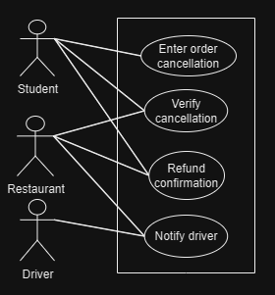
Order Cancel
Use case diagram: U-5
Student enters the cancellation request. (i.e., their reason for canceling)
The restaurant will verify the cancellation with the restaurant
After verification, the order will be cancelled, and payment refunded
The driver will be notified and cancel the delivery

Slide 27
Order Cancel: U-5
Use Case Name: Order cancel Priority: High |  |  |  | ID: U-5
Short Description: User orders food in the BP Eats app, but decides they want to cancel their order.
Trigger: User wants to cancel their order Type: External / Temporal
Major Inputs: |  | Major Outputs:
Description: Order info reason for cancellation payment info Driver info | Source: User Driver | Description: Order cancelation receipt Email that shows order canceled, and money refunded to the account | Destination: System application System Database User
Major Steps Performed: - The user cancels their order before their order is picked up for delivery - The system asks the user the reason for cancelling - The system verifies the cancellation and checks the current status of the order - The system generates an order cancellation receipt and email, then notifies the driver |  | Information for steps: User order cancellation request Reason for order cancellation User student email, cancellation confirmation receipt, order info Driver info, student payment info, cancellation receipt

Slide 28
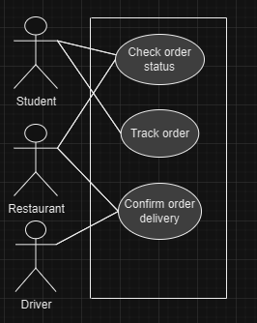
Order Status
Use case diagram: U-5
Student checks the status of their order
Student can track their order via the BPeats app
The driver confirms the order delivery with the student, restaurant, and the system

Slide 29
Order Status: U-6
Use Case Name: order status Priority: High |  |  |  | ID: U-1
Short Description: Users can check the order status of their order and see delivery tracking in real time
Trigger: User wants to check their order status Type: External / Temporal
Major Inputs: |  | Major Outputs:
Description: Order info Driver info Restaurant info | Source: User Driver Restaurant | Description: Order is checked with the restaurant and the driver and relays the status | Destination: System application
Major Steps Performed: The user checks their order status. The system verifies if the order is still in preparation, or if the order is on its way. The system sends a notification if the order is done with preparation, has been picked up, or is on route via delivery The user can track their order in the system in real time The order delivery status is confirmed by the driver via photo between the user and the restaurant The User account and restaurant account gets a notification of successful delivery after the driver confirms it. The Driver gets paid via tip and the job is marked as complete |  | Information for steps: Order info Restaurant, driver info, driver tracking Order info, restaurant, driver info, driver tracking Driver info, Driver tracking Driver info, user info, order info, restaurant info Driver info, user info, order info, restaurant info Driver info

Slide 30
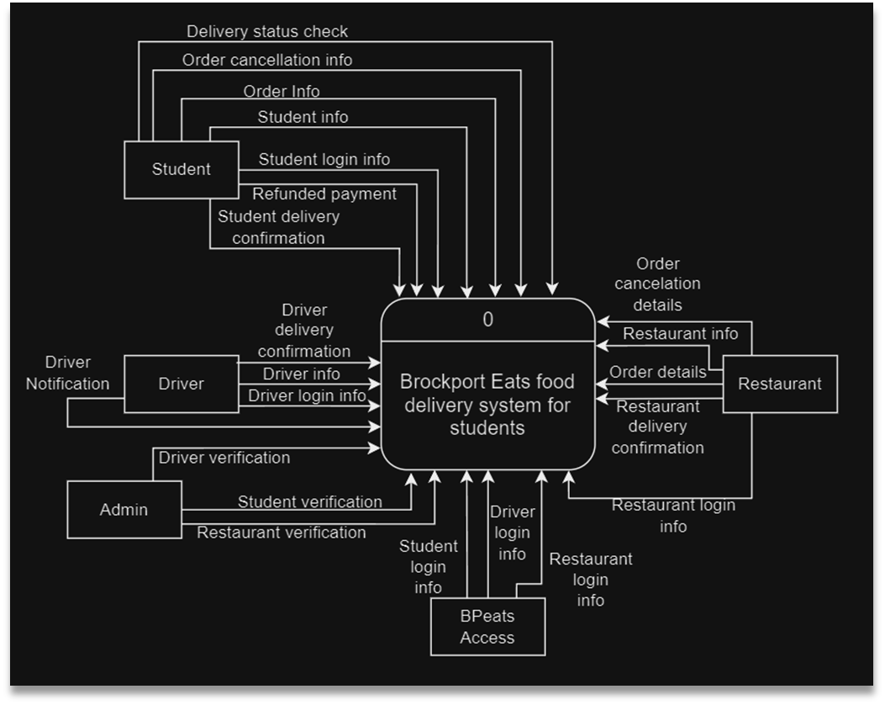
WIP needs to be fixed

Slide 31
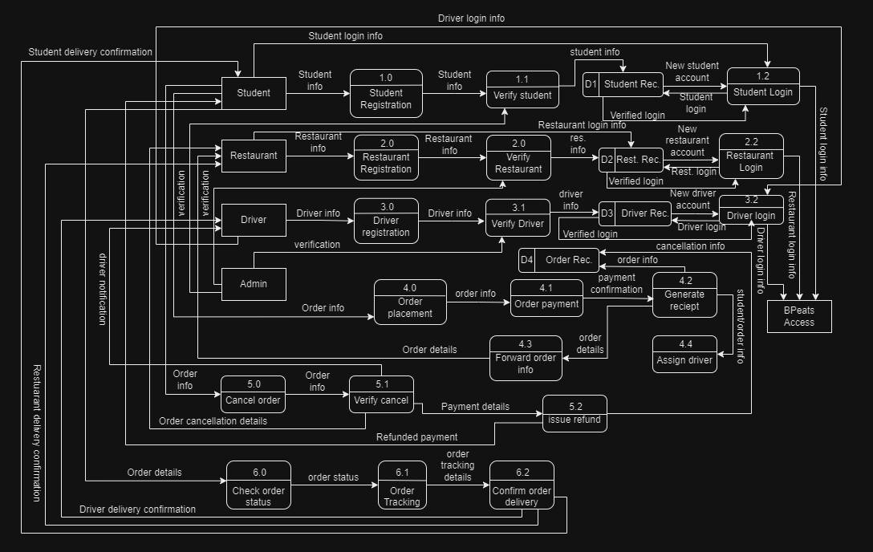

Slide 32
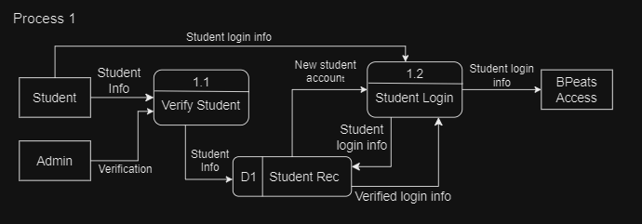
Process 1

Slide 33
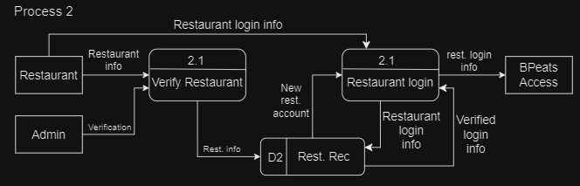
Process 2

Slide 34
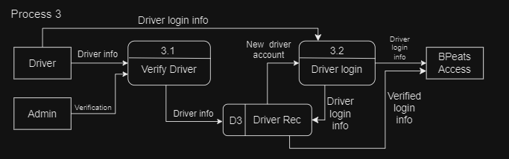
Process 3

Slide 35
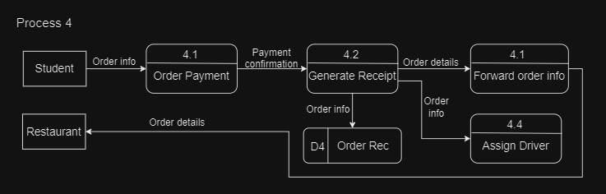
Process 4

Slide 36
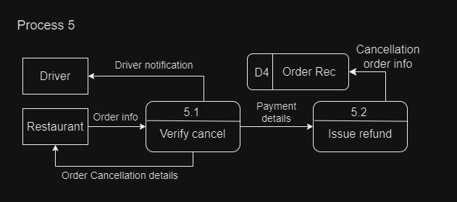
Process 5

Slide 37
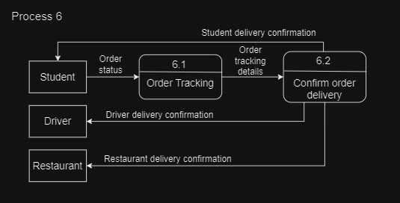
Process 6

Slide 38
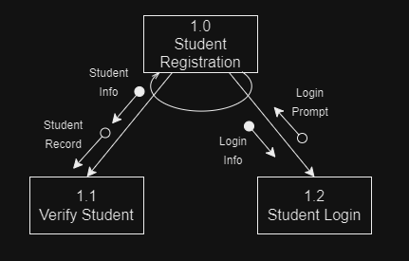
Structure Chart 1

Slide 39
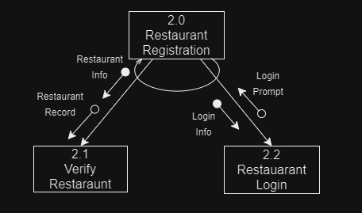
Structure Chart 2

Slide 40
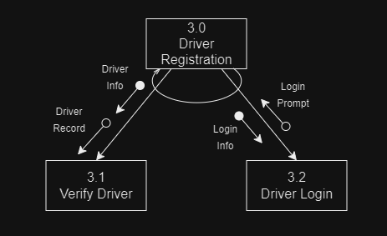
Structure Chart 3

Slide 41
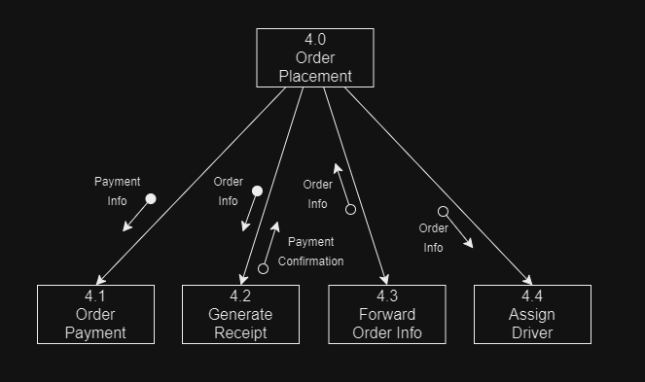
Structure Chart 4

Slide 42
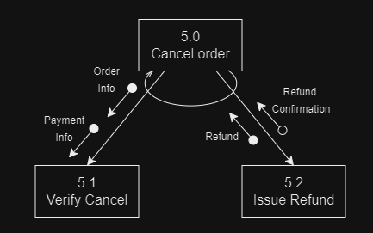
Structure Chart 5

Slide 43
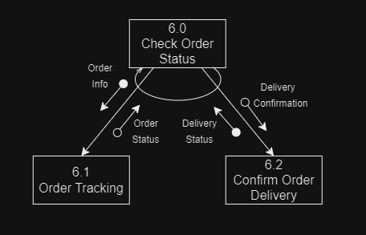
Structure Chart 6

Slide 44
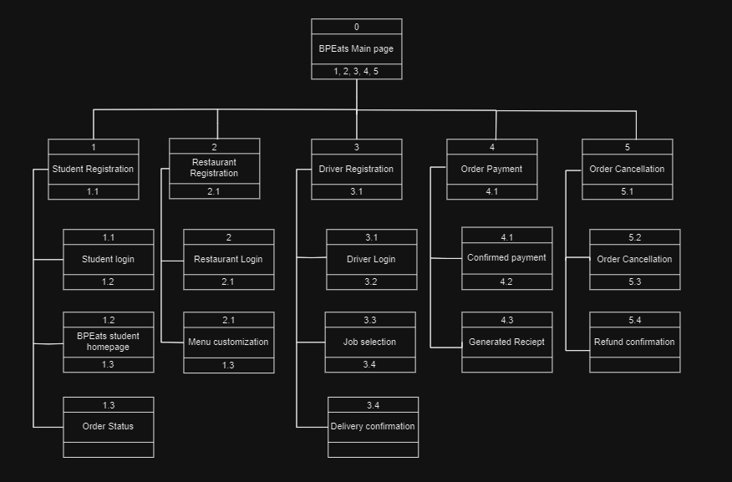

Slide 45
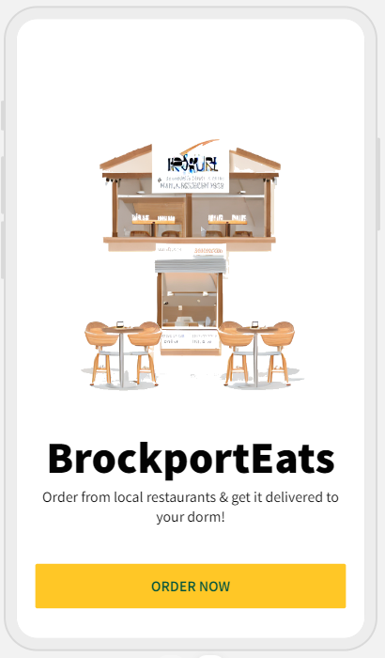
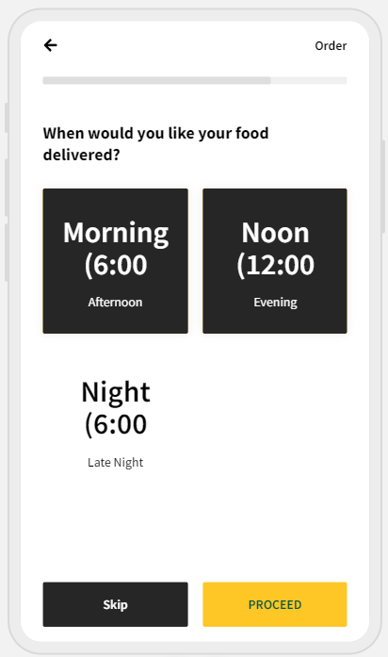
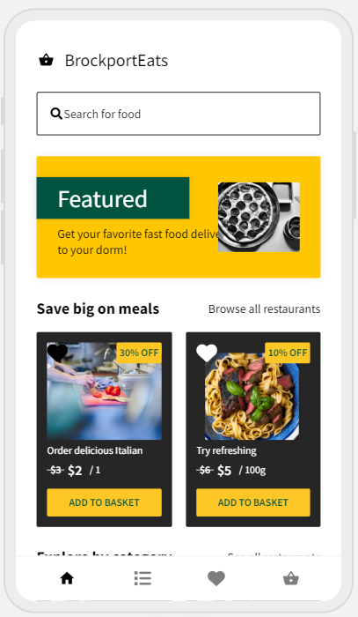
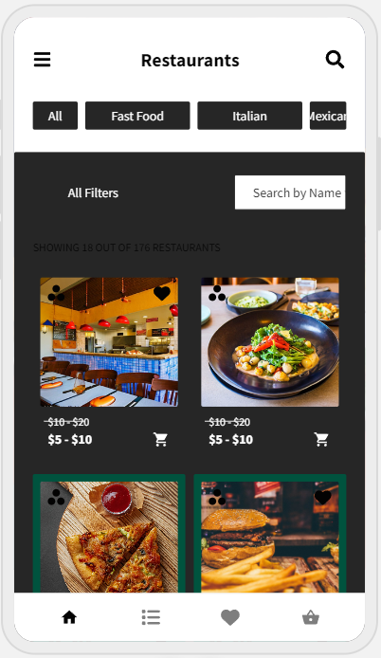
App Design

Slide 46
Test Plan Page 1 of 1
Program ID: BrockportEats
Version Number: 1.0
Tester:
Date Designed:
Date Conducted:
Results: Passed
Test ID: 001
Requirement addressed: User Registration
Objective: To ensure that users can successfully register on the BrockportEats app.
Script:
Open the BrockportEats app.
Navigate to the registration page.
Enter the user's name, email, password, and confirm password.
Click the "Register" button.
Expected Results/Notes:
• User is successfully registered, and a confirmation message is displayed.
Actual Results/Notes:
• The registration process completed successfully. A confirmation email was sent to the provided email address, and the user is able to log in with the registered credentials.
Test Case 1 of 2
Interface ID | Data Field | Value Entered
User Interface | Name | John Doe
User Interface | Email | john.doe@example.com
User Interface | Password | test@1234
User Interface | Confirm Password | test@1234

Slide 47
Test Plan Page 1 of 1
Program ID: BrockportEats
Version Number: 1.0
Tester:
Date Designed:
Date Conducted:
Results: Passed
Test ID: 007
Requirement addressed: App Navigation
Objective: To confirm that users can navigate between screens seamlessly.
Script:
Open the BrockportEats app.
Navigate to the home screen.
Access the menu screen.
Navigate to the user profile screen.
Expected Results/Notes:
Users can navigate between the home screen, menu screen, and user profile screen without encountering errors.
Actual Results/Notes:
The navigation between screens was smooth and without any delays. Each screen displayed the expected content, and the transition between screens was seamless. No errors or unexpected behaviors were observed during the navigation process.
Test Case 2 of 2
Interface ID | Data Field | Value Entered
Navigation Interface | Home Screen | N/A
Navigation Interface | Menu Screen | N/A
Navigation Interface | User Profile Screen | N/A

Slide 48
References
Hillman, Tricia. BP Eats Interview. Conducted by Dominic Adu Agyei, Yusuf Unsal, Aschby Gurpersaud. 12 October 2023.
Coworkers from local businesses. BP Eats Interview. Conducted by Dominic Adu Agyei, Yusuf Unsal, Aschby Gurpersaud. 11 September 2023.
Classmates/students (future users). BP Eats Interview. Conducted by Dominic Adu Agyei, Yusuf Unsal, Aschby Gurpersaud. 8 September 2023.
Multiple RA's. BP Eats Interview. Conducted by Dominic Adu Agyei, Yusuf Unsal, Aschby Gurpersaud. 8 September 2023.
“Manage Operations with the Uber Eats Orders App | Uber Eats.” Uber Eats, Uber Eats, merchants.ubereats.com/us/en/technology/manage-orders/uber-eats-orders-app/. Accessed 14 Sept. 2023.
“How DoorDash’s Strategy Achieved Food Delivery Domination.” Latana.com, resources.latana.com/post/doordash-success-story/. Accessed 29 Sept. 2023.

Slide 49
THE END
Thanks For Listening
Any Questions?

